Slide 1
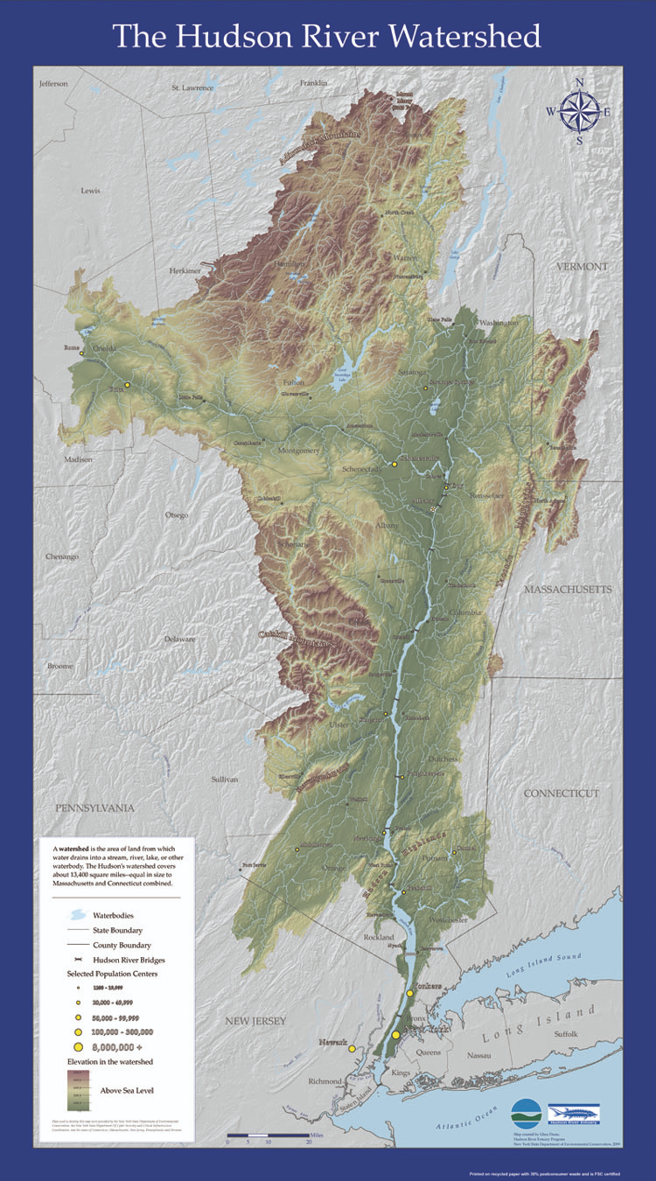
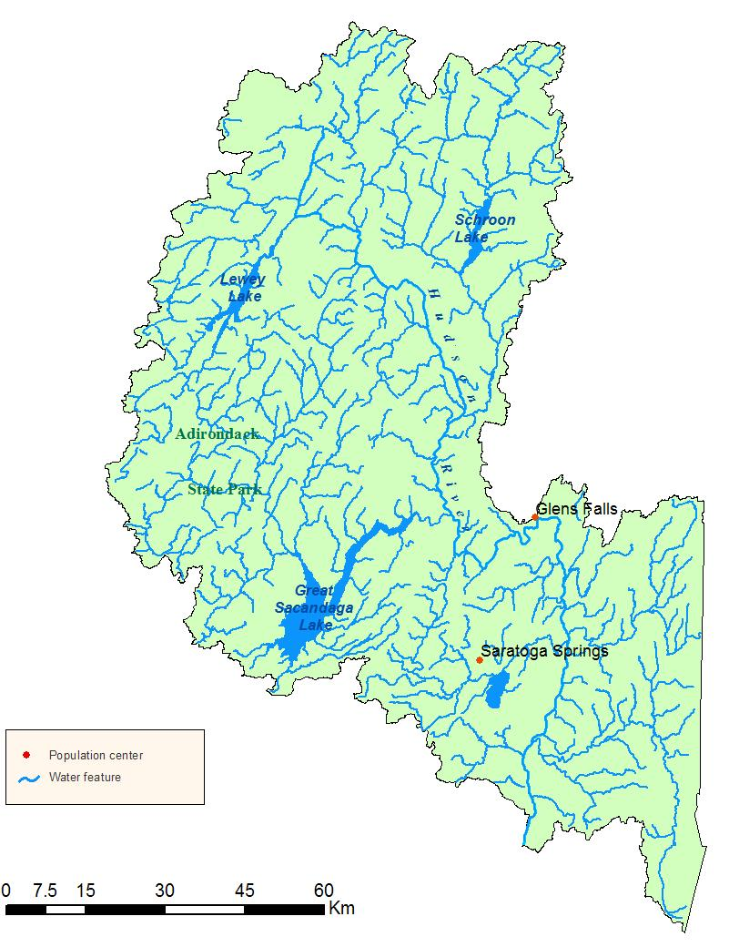
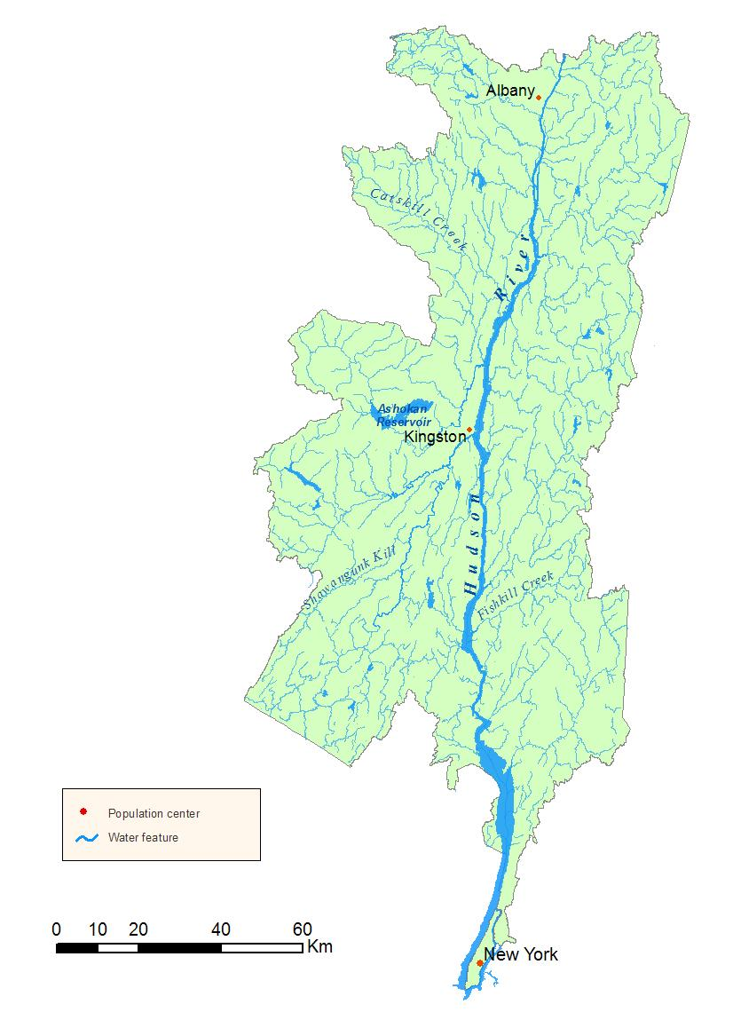
Upper Hudson
Lower Hudson

Slide 2
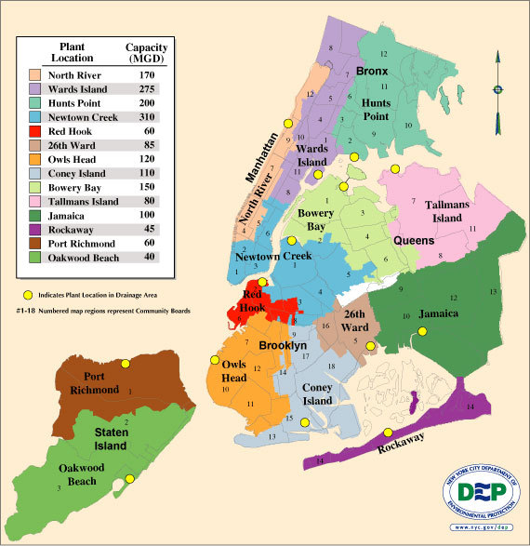
NYC “Sewershed”

Slide 3
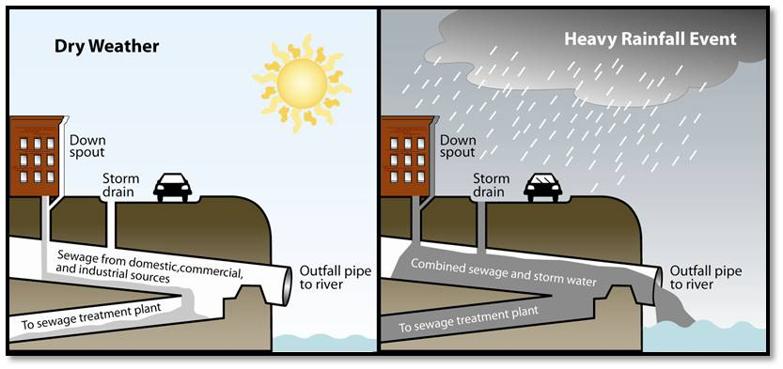
Combined Sewer System & Combined Sewer Overflows (CSO)

Slide 4
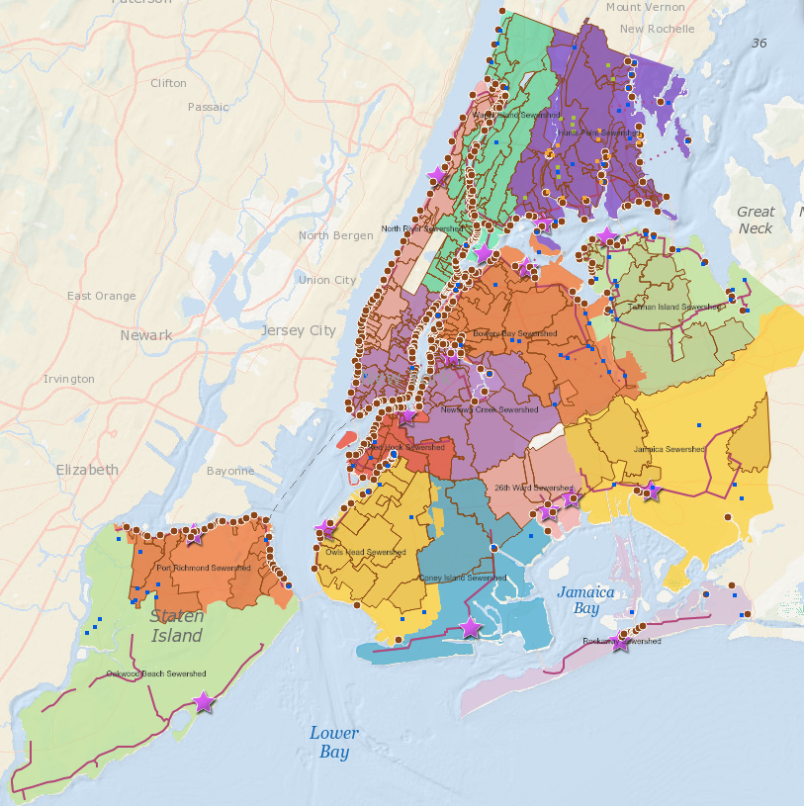
CSO Outfall Map
New York City has 450+ CSO outfalls from the Harlem River to the Gowanus Canal
CSOs discharge over 20 billion gallons of polluted water into NYC waterways each year
Combined sewer systems make up ~60% of New York City's sewershed
Credit: SWIM Coalition / Open Sewer Atlas

Slide 5
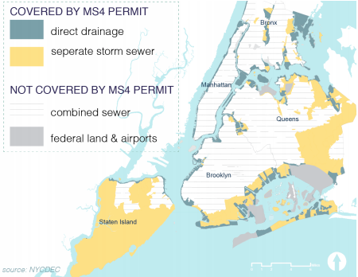
Municipal Separate Storm Sewer System (MS4)

Slide 6
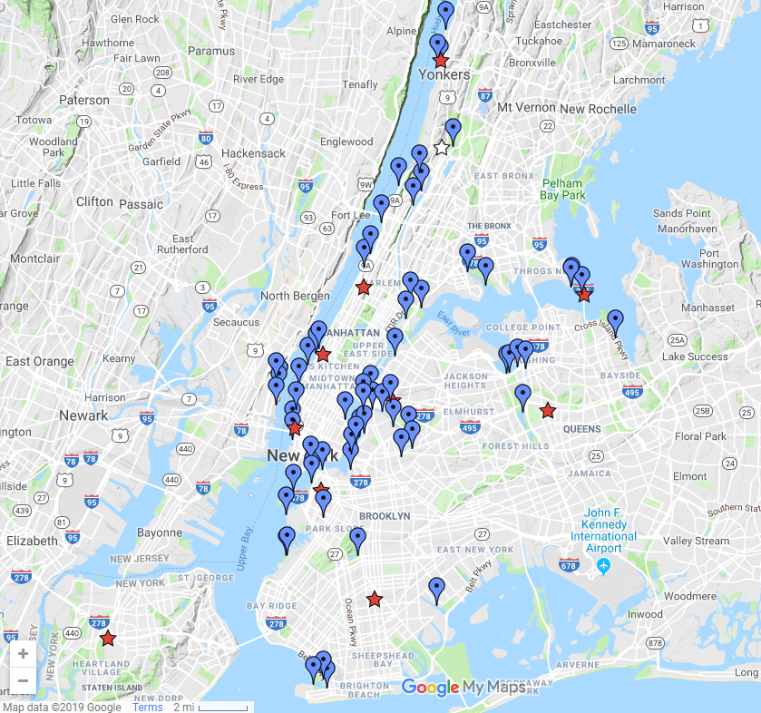
Citizens’ Water Quality Testing Program
= Sampling site; includes boat launches and other water access points
= CWQTP laboratory

Slide 7
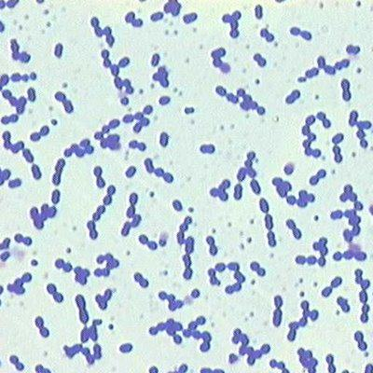
Enterococci as fecal indicator bacteria
Found in fecal matter of warm-blooded animals
Strong correlation between swimmer illness and enterococci levels (although entero probably don’t cause illness)
Survive in salt water
Generally not found in environment
Considerations
Killed by UV
Somewhat associated with particulate matter
Boehm AB, Sassoubre LM. Enterococci as Indicators of Environmental Fecal Contamination. 2014

Slide 8
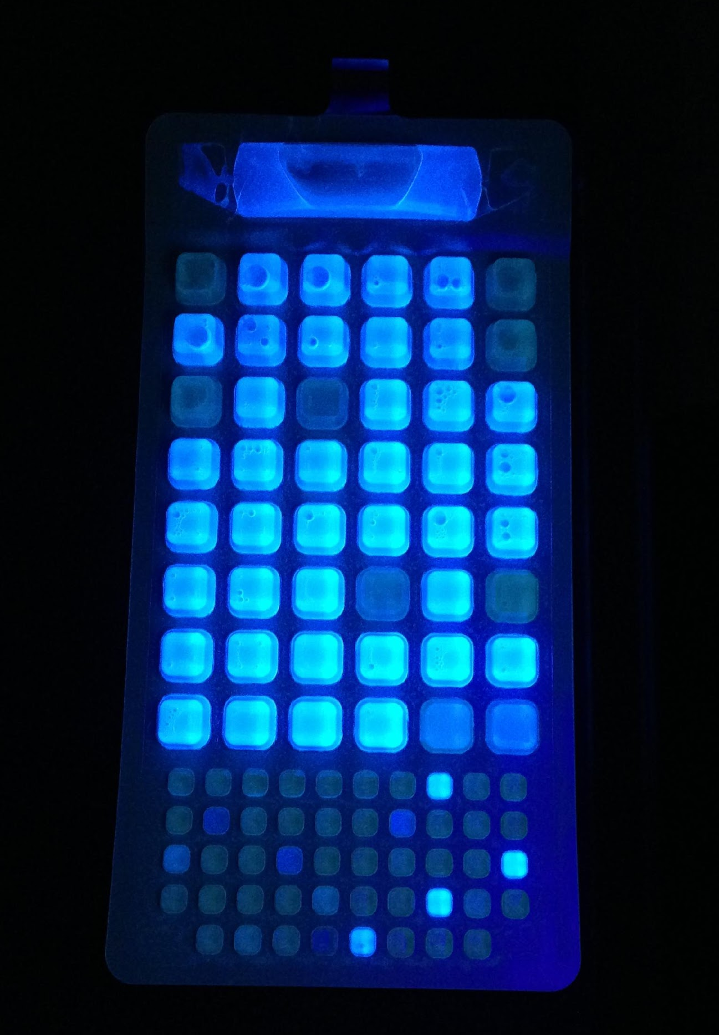
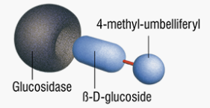
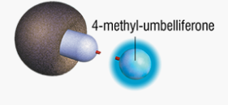
IDEXX Enterolert method for detecting Enterococcus
Results in 24 hours
Enumerates <10 – 24,190 enterococci per 100 mL brackish water
EPA-approved method
Wells containing enterococci fluoresce
Enzyme cleaves reagent, producing fluorescent molecule
Enzyme found in enterococci
Reagent: modified carbohydrate

Slide 9
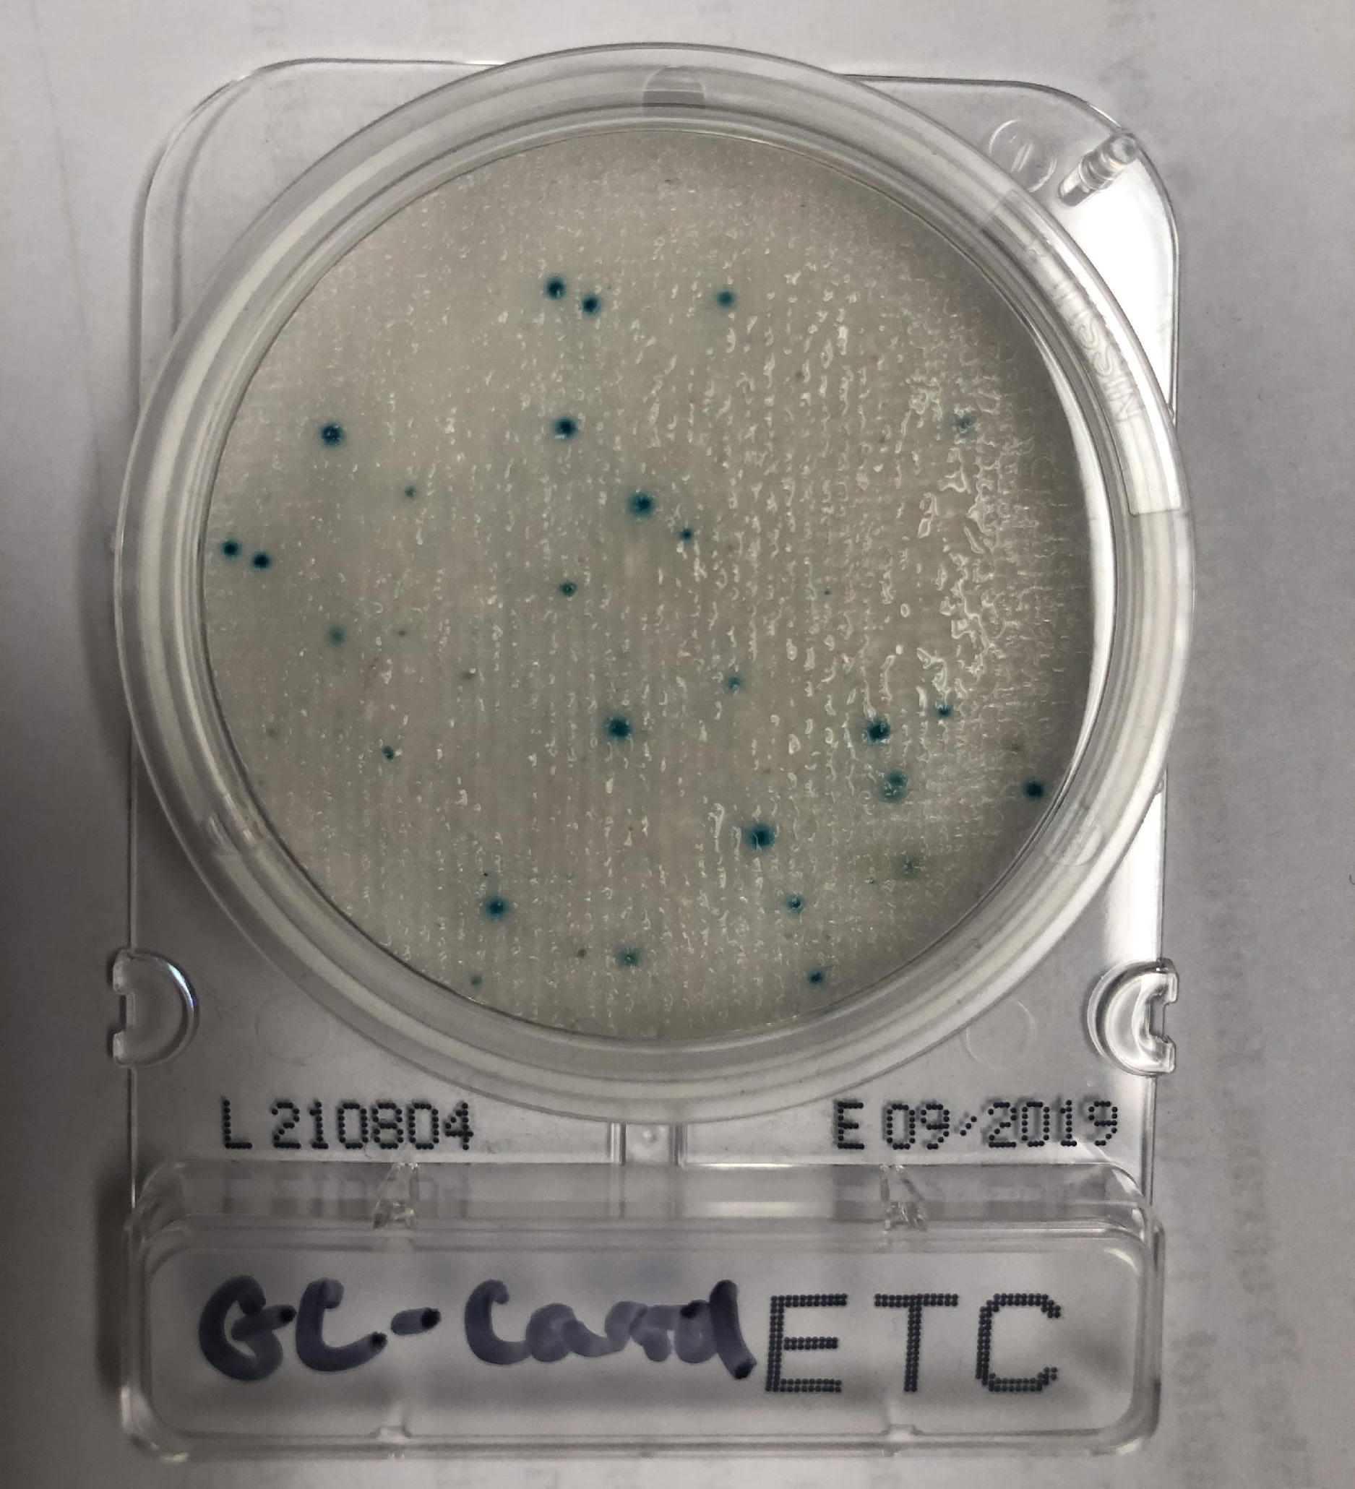
HyServe Compact Dry ETC method
Results in 24 hours
Lower equipment cost
Enumerates 100-30,000 enterococci per 100 ml
Not EPA-approved
Enterococcus colony.
X-glucoside in media is cleaved by Enterococcus enzyme that produces blue product
Media contains antibiotics that kill bacteria other than Enterococcus

Slide 10
Aseptic Technique
Sterile work surface
uncluttered work area
wipe down work surface with bleach or 70% ethanol
Personal hygiene & protective gear
wash hands past wrists before/after lab work
always wear lab gloves while working in lab
do not touch face, body, unsterile surfaces/items with gloves
Sterile Handling
only use pipettes once to avoid cross-contamination
pipette should transfer from one vessel to the next without touching other surfaces
only uncover a vessel when you are ready to use it and replace cap as soon as possible

Slide 11
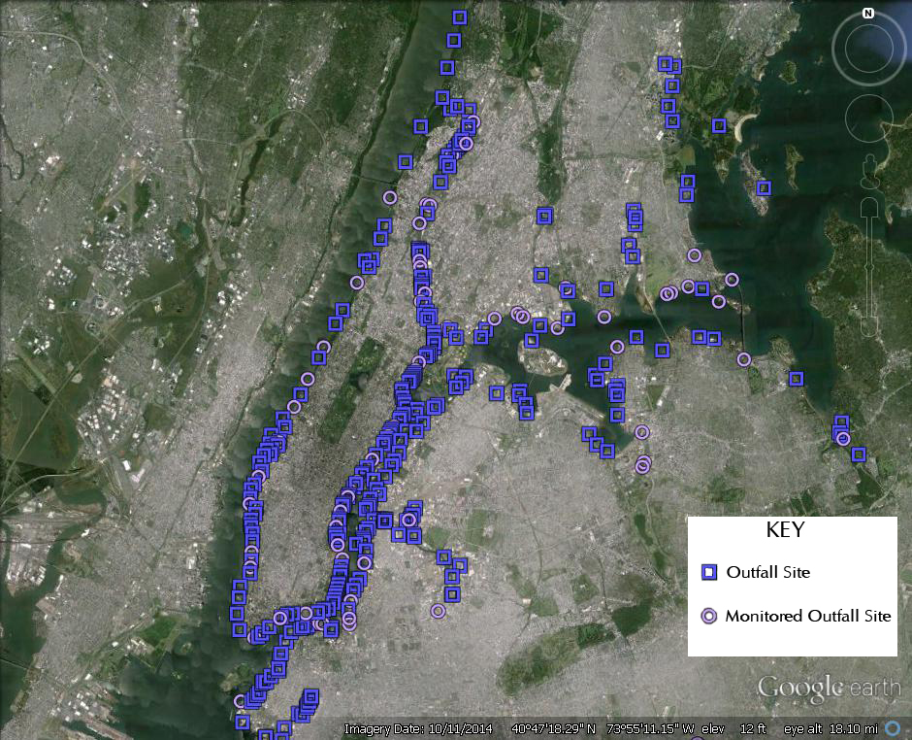
by NYC DEP

Slide 12
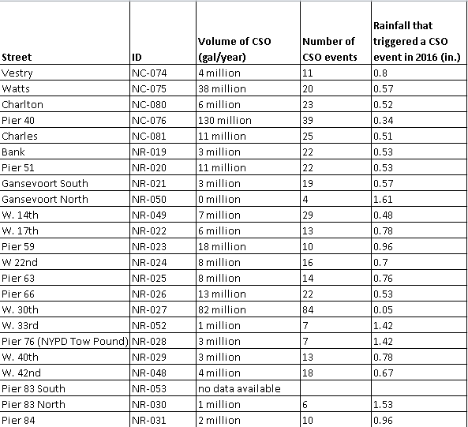

Slide 13
NYC DOH Enterococcus Standards (for swimming)
Green: <35 MPN--acceptable
Yellow: 35-104 MPN--unacceptable if levels persist
Red: >104 MPN--unacceptable

Slide 15
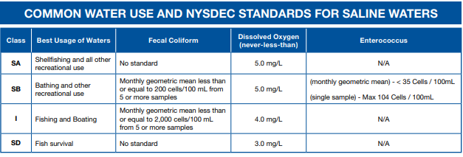
*
*A geometric mean is a weighted average that is less sensitive to outliers than an arithmetic mean

Slide 16
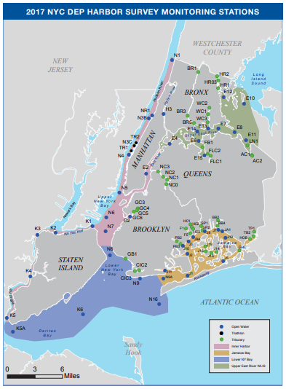
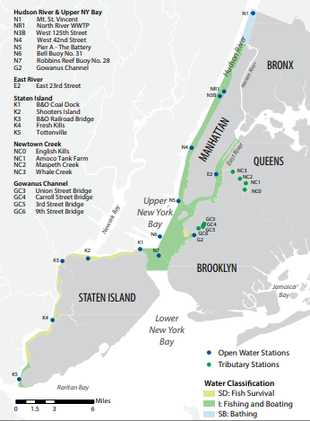
Notes:
maps taken from 2017 Harbor Survey Monitoring Stations

Slide 17
Fecal Coliform Bacteria
<100 count/100mL
100 - 200
201 - 2000
>2000

Slide 18
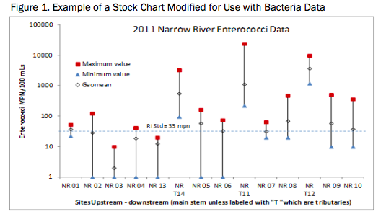
http://norwalkriver.org/wpcontent/uploads/2014/11/NR-winter-report-Oct-2010-through-April-2011.pdf
http://blog.uvm.edu/kstepenu/files/2016/11/Bact-Present_XV.pdf

Slide 19
San Antonio River Authority: https://www.sara-tx.org/apps/bacteria_charts/ecoli_chart_logrithm.php
http://blog.uvm.edu/kstepenu/files/2016/11/Bact-Present_XV.pdf

Slide 20
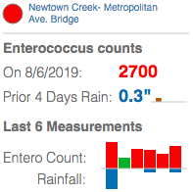
https://www.riverkeeper.org/water-quality/hudson-river/nyc-hudson-bergen/newtown-creek-metropolitan-ave-bridge/

Slide 21
